Slide 1


Slide 2

Thiago Barradas
Software Enginner | Mundipagg
[ Web Applications ] [ ASP .NET ]
[ API RESTful ] [ Microsoft ♥ Linux ]
[ Elasticsearch ] [ Docker ]
[ DevOps ] [ Agile ]
tbarradas@mundipagg.com
LinkedIn: thiagobarradas
(21) 99329-9143

Slide 3


ELASTIC STACK
DATA PROCESSING & DATA STREAMING COM LOGSTASH, BEATS E INGEST NODE

Slide 4

Breve agenda
Elastic Stack
Logstash
Beats
Arquitetura com Elastic Stack
Mão na massa!

Slide 5

ELASTIC STACK

Slide 6
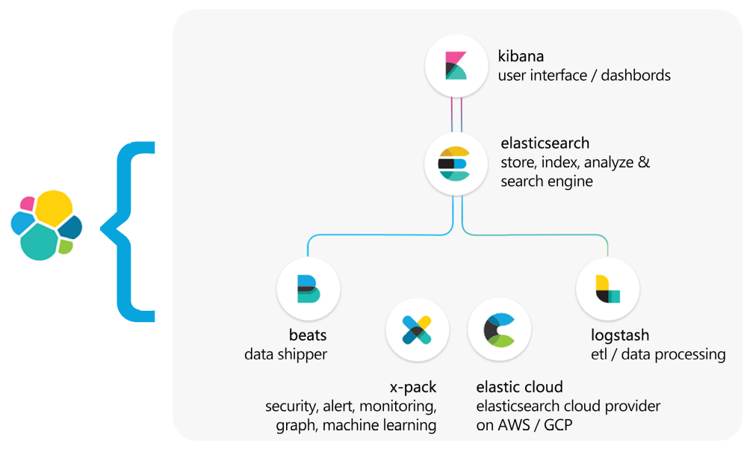
Elastic
Stack

Slide 7


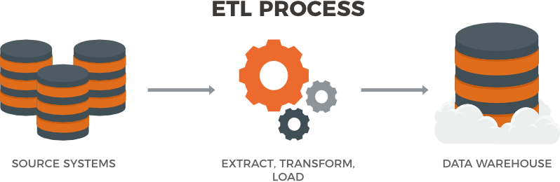
Data Processing & Data Streaming
ELASTIC STACK

Slide 8
LOGSTASH

Slide 9
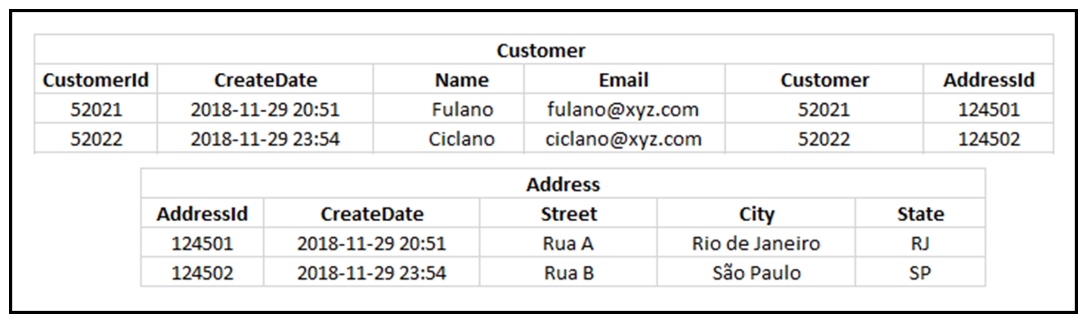
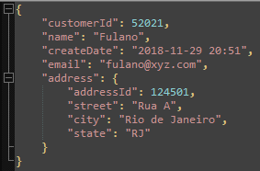
input
filter output

Slide 10
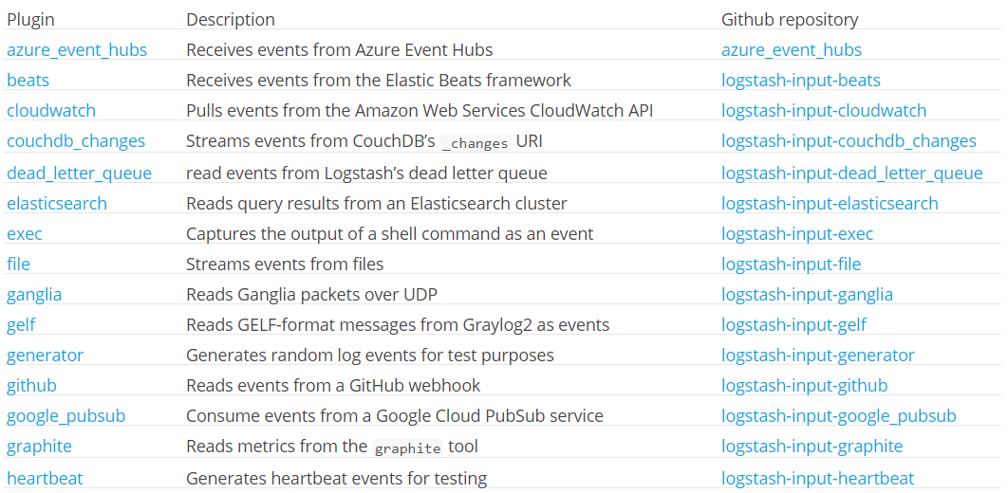
Input plugins
LOGSTASH

Slide 11
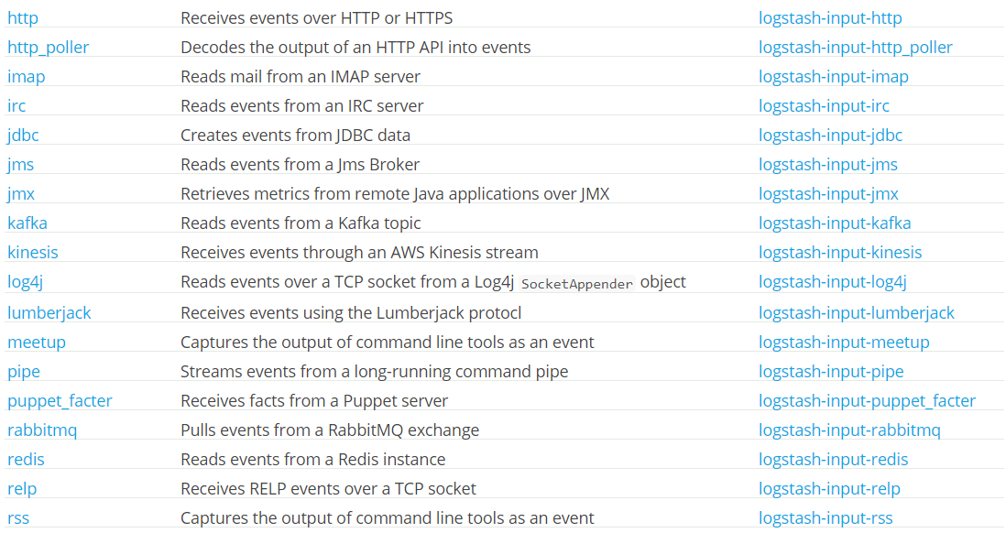
Input plugins
LOGSTASH

Slide 12
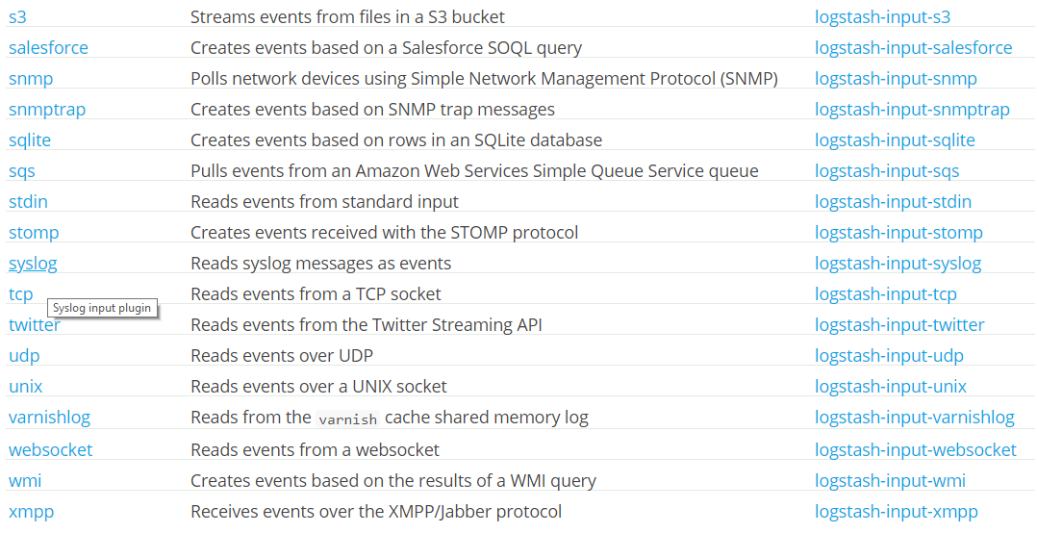
Input plugins
LOGSTASH

Slide 13
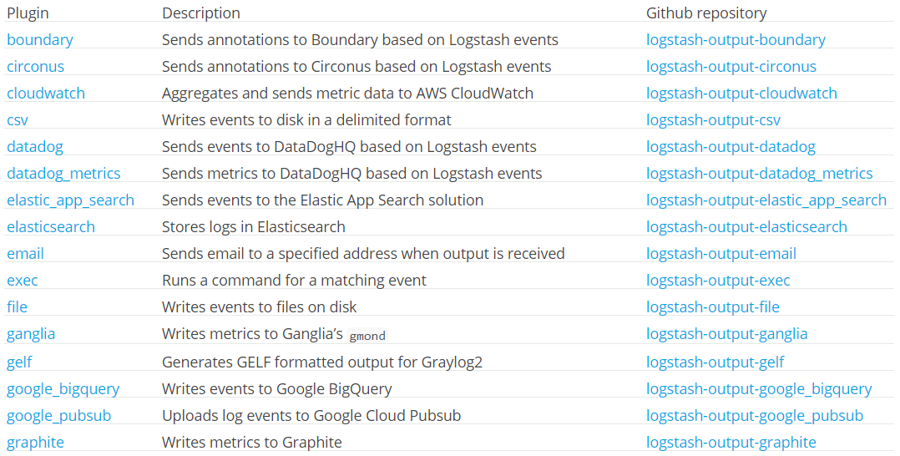
Output plugins
LOGSTASH

Slide 14
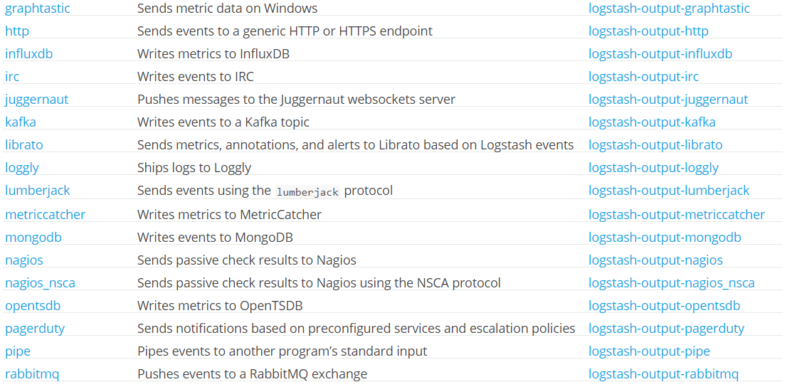
Output plugins
LOGSTASH

Slide 15
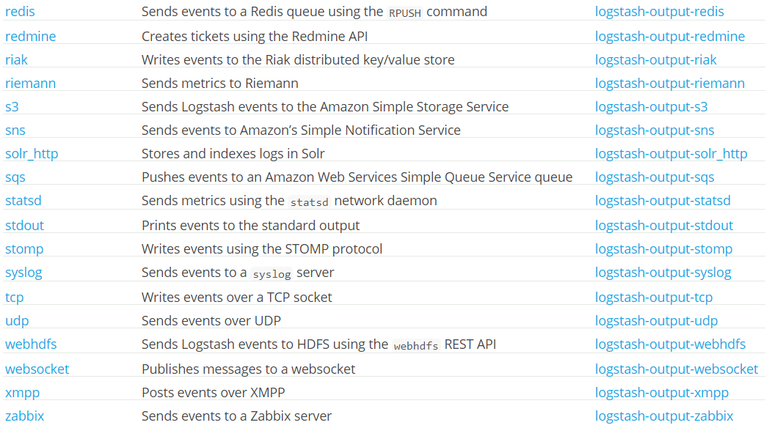
Output plugins
LOGSTASH

Slide 16
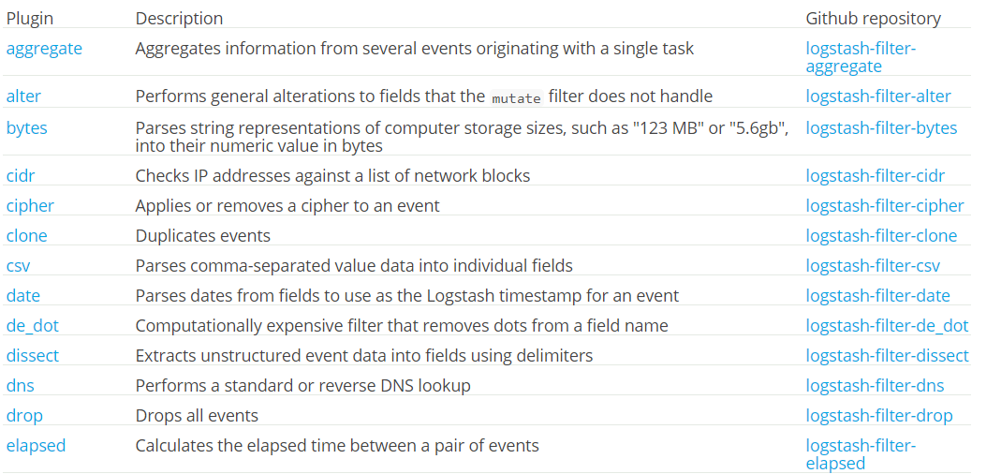
Filter plugins
LOGSTASH

Slide 17
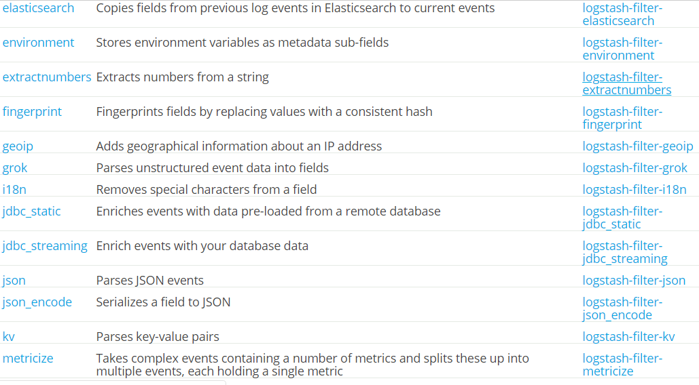
Filter plugins
LOGSTASH

Slide 18
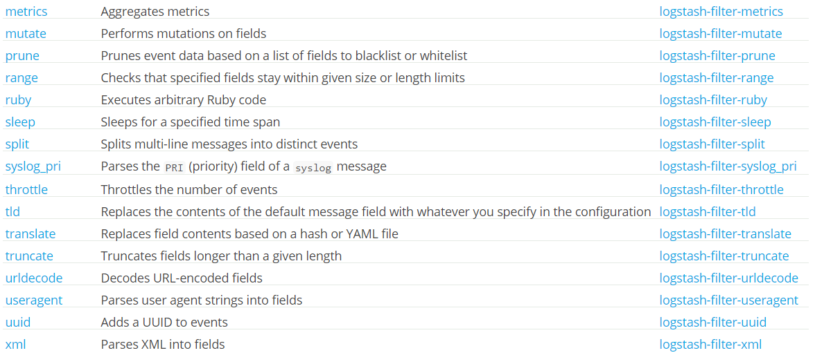
Filter plugins
LOGSTASH

Slide 19
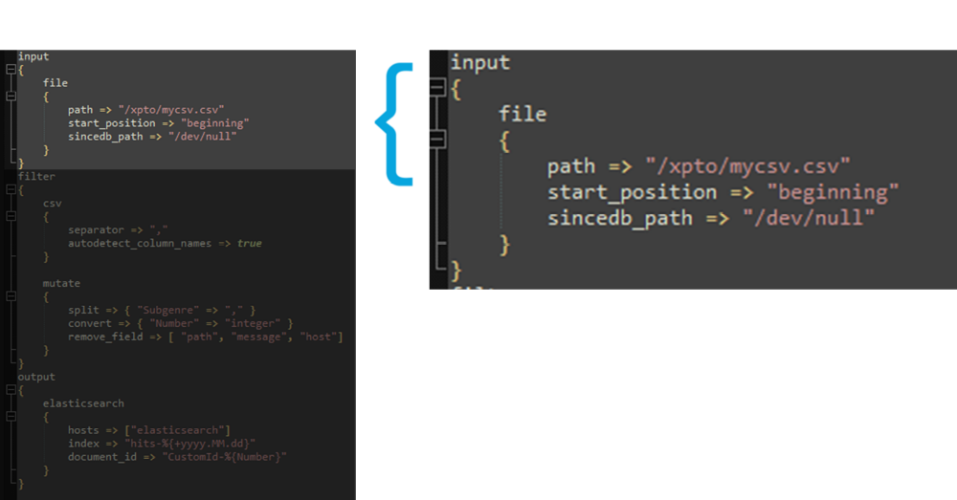
Exemplo de configuração
LOGSTASH

Slide 20
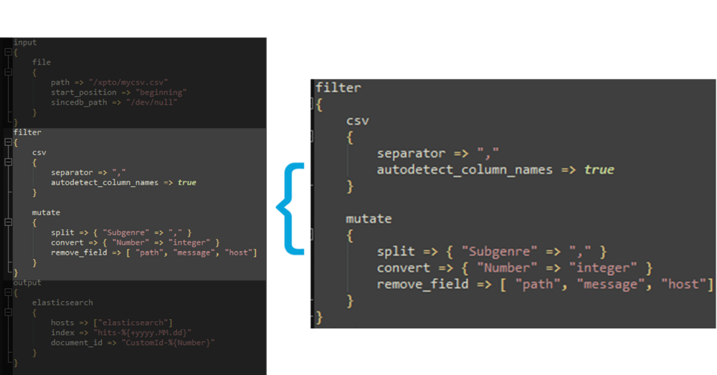
Exemplo de configuração
LOGSTASH

Slide 21
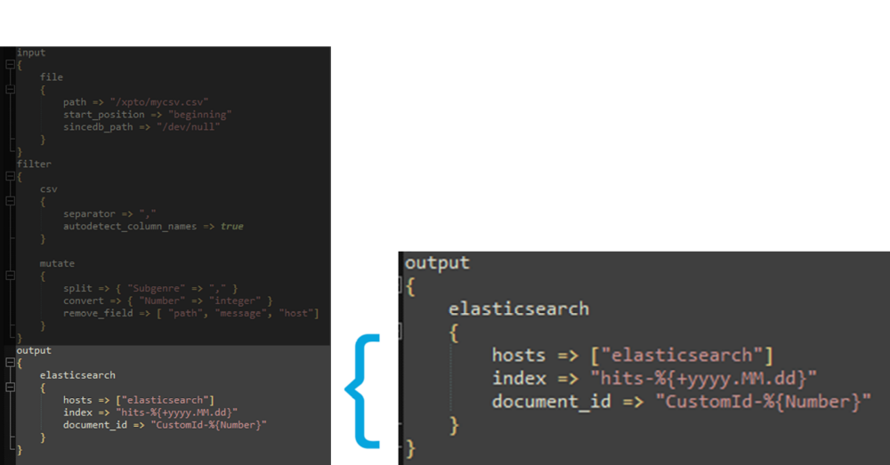
Exemplo de configuração
LOGSTASH

Slide 22
BEATS

Slide 23
input
output

Slide 24
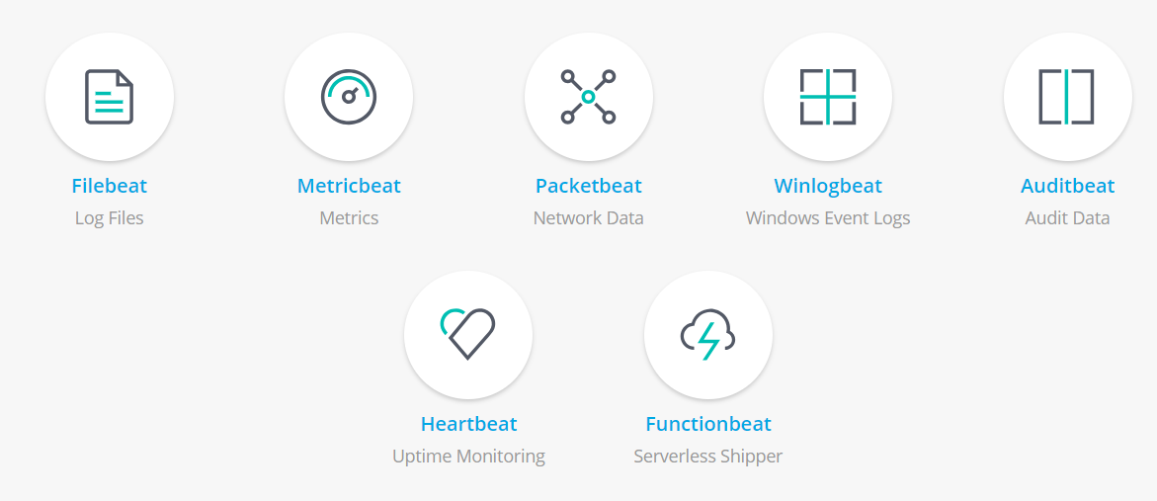
Beats family
BEATS

Slide 25
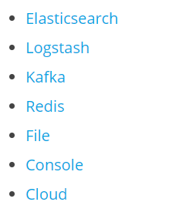
Output
BEATS

Slide 26
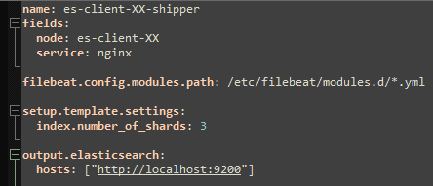
Exemplo de configuração
BEATS

Slide 27
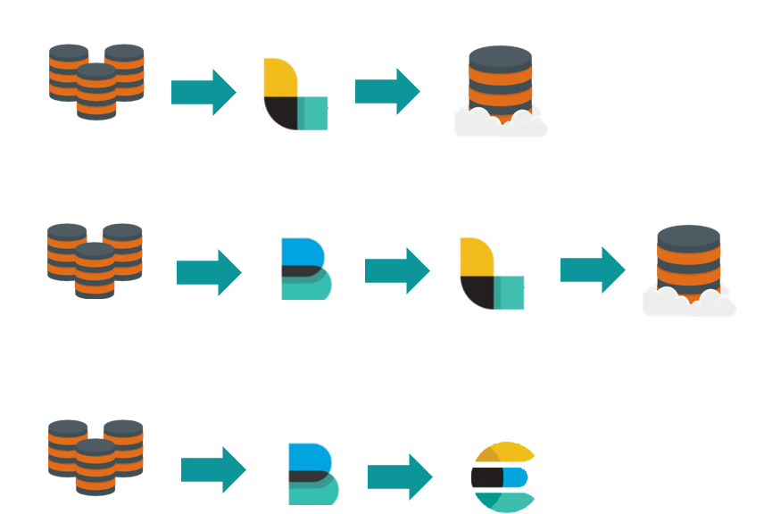
Fluxos

Slide 28
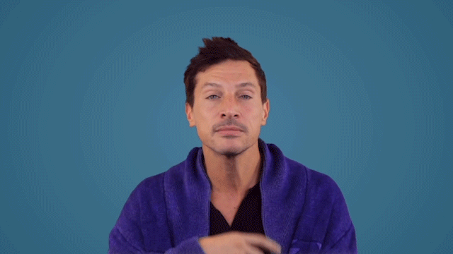

Slide 29
Links:
https://medium.com/thiagobarradas
https://github.com/ThiagoBarradas/logstash-beats-demo
https://www.elastic.co/guide/en/logstash/current/introduction.html
https://www.elastic.co/guide/en/logstash/current/input-plugins.html
https://www.elastic.co/guide/en/logstash/current/filter-plugins.html
https://www.elastic.co/guide/en/logstash/current/output-plugins.html
https://www.elastic.co/guide/en/beats/filebeat/current/index.html
https://www.elastic.co/guide/en/beats/filebeat/current/configuring-output.html

Slide 30
Thiago Barradas
tbarradas@mundipagg.com
+55 (21) 99329-9143
Linkedin: thiagobarradas
Obrigado!

